Slide 1
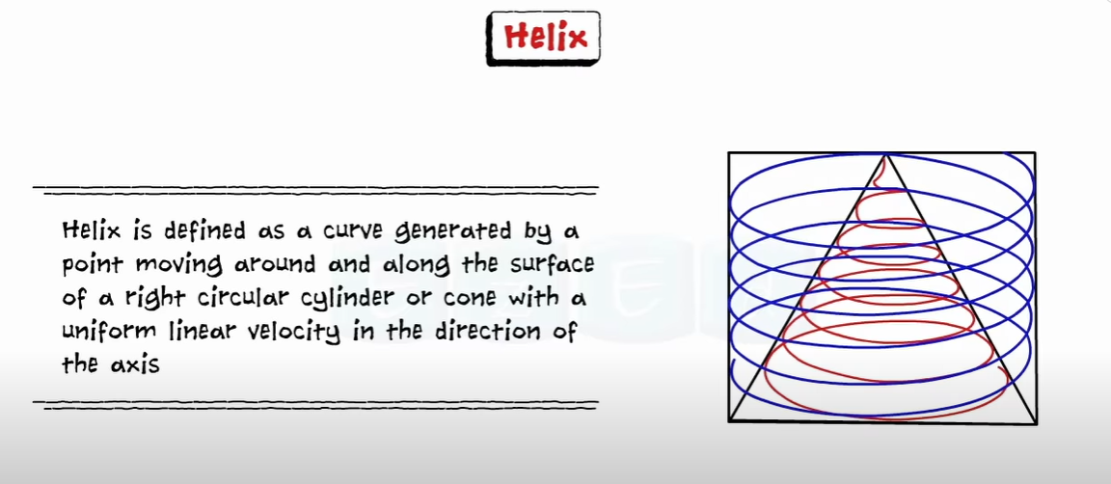

Slide 2
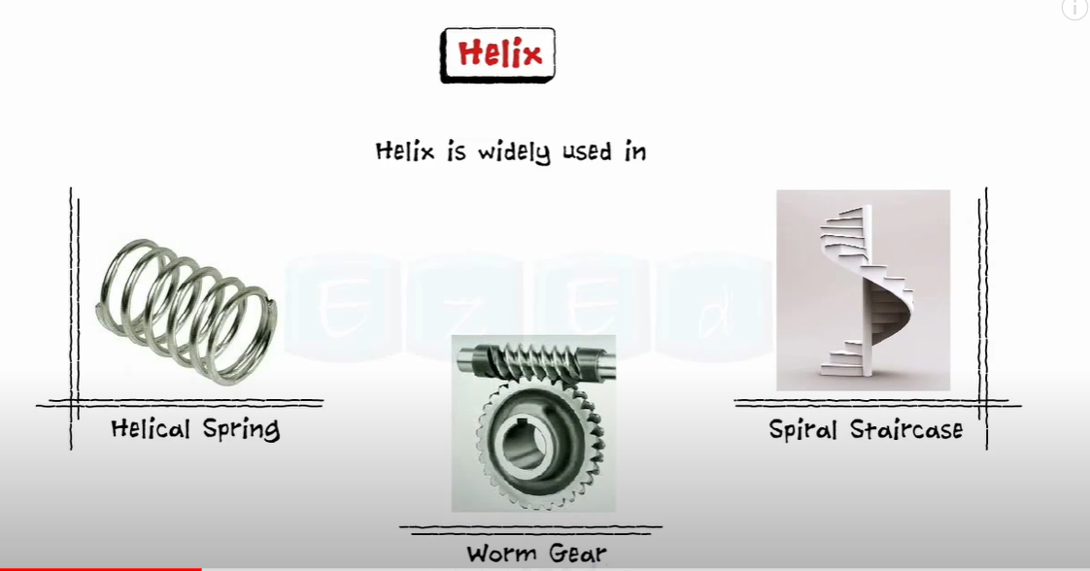

Slide 3
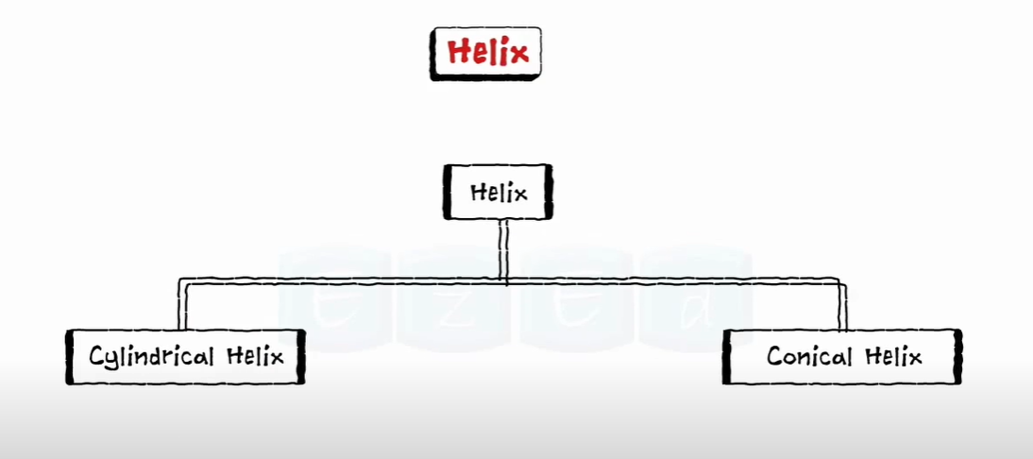

Slide 4
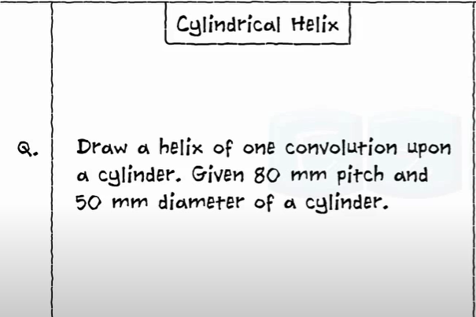

Slide 5
Steps to Construct Helix :
1. Draw a rectangle with the height and width which is equal to the length and
diameter of a cylinder.
2. With a specific distance draw a circle which represents the front and top view of a
cylinder.
3. Divide a circle into equal number of parts and assign numbers as follows: 1,2,3 etc
4. With the same number divide rectangle into equal number of parts and assign numbers like 1’,2’3’….
5. Draw horizontal lines from every division point of rectangle.
6. Draw vertical lines from every circle point which intersect horizontal line of rectangle. For Example : 1-1’ , 2-2’ , 3-3’ ……
7. Mark intersection points and draw an arc.

Slide 6
8’
Helix
7’
6’
5’
4’
3’
80 mm
2’
1’
50 mm
6
7
5
8
4
1
3
2

Slide 7
2
Spiral :
3
1
4
P
8
7
6
5
4
3
2
1
5
7
6

